Slide 1
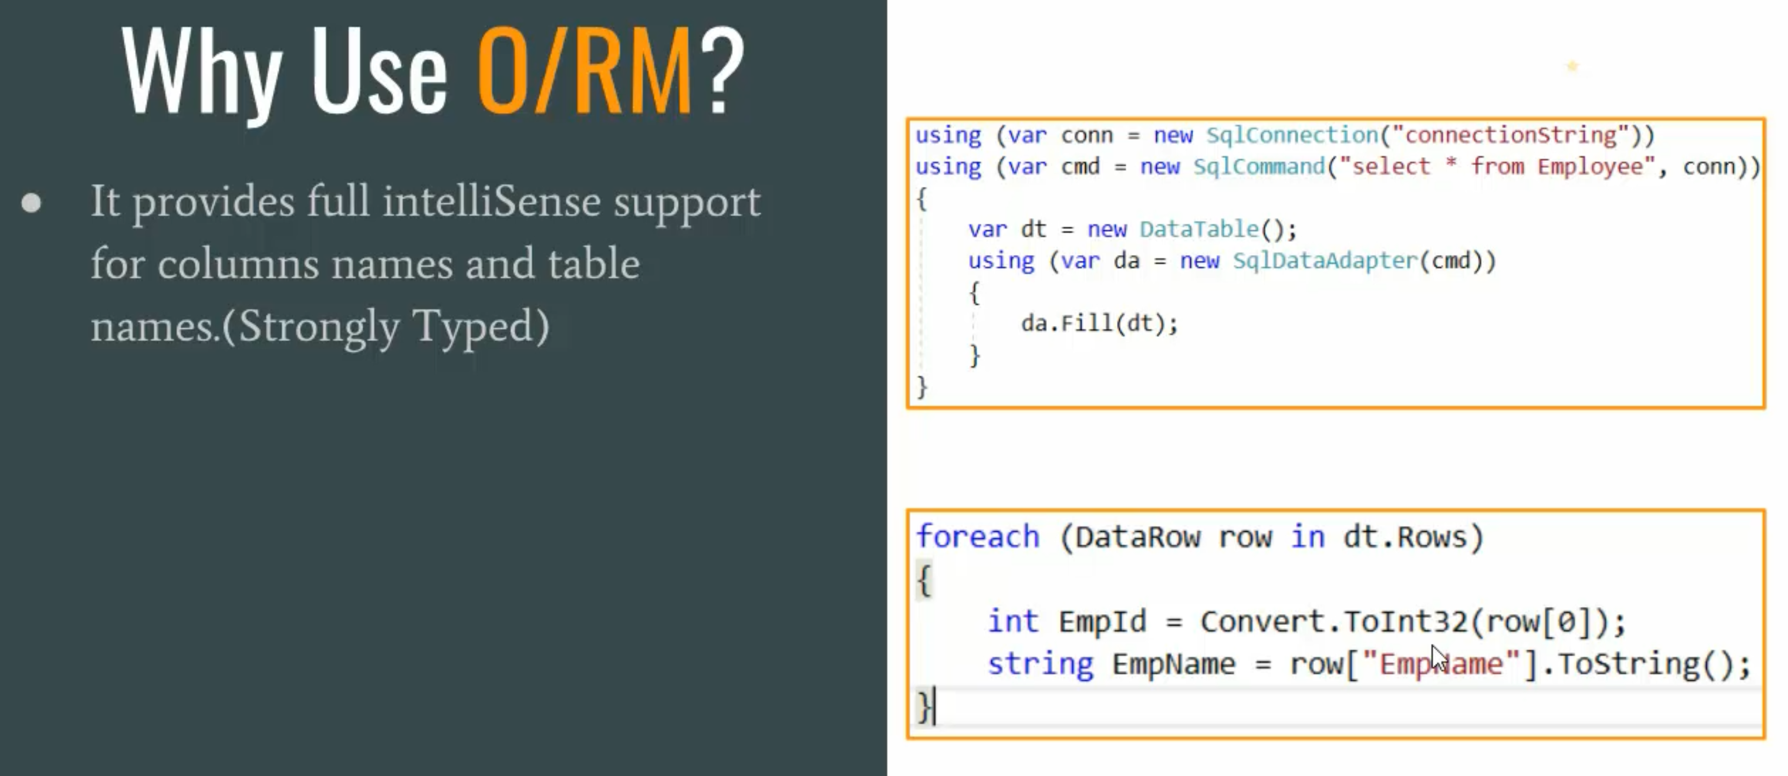

Slide 2
What is EF Core?
EF Core is an ORM too.
Entity Framework Core is the latest data access technology for .Net Developers.
EF Core has almost same interface as EF6.X.
EF Core can be used to access NoSQL DB. Where as EF6.X cannot.
EF Core can run on Windows, Linux, and Apple. Where as EF6.X is only for Win
Thre are two approaches of working with EF Core
Code-First
Database-First(Reverse Engineering)

Slide 3
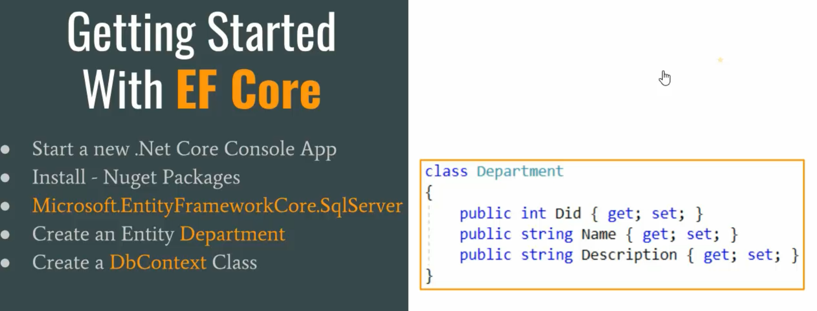
DbContext is the top-level object that manages database connection and provides the functionalities on database like Create, Read, Update, and Delete operations.
Our main data access class using which we perform all the operations should be inherited from DbContext class.
Our OrganizationContext class should have DbSet<Tentity> properties for each entity or object.

Slide 4
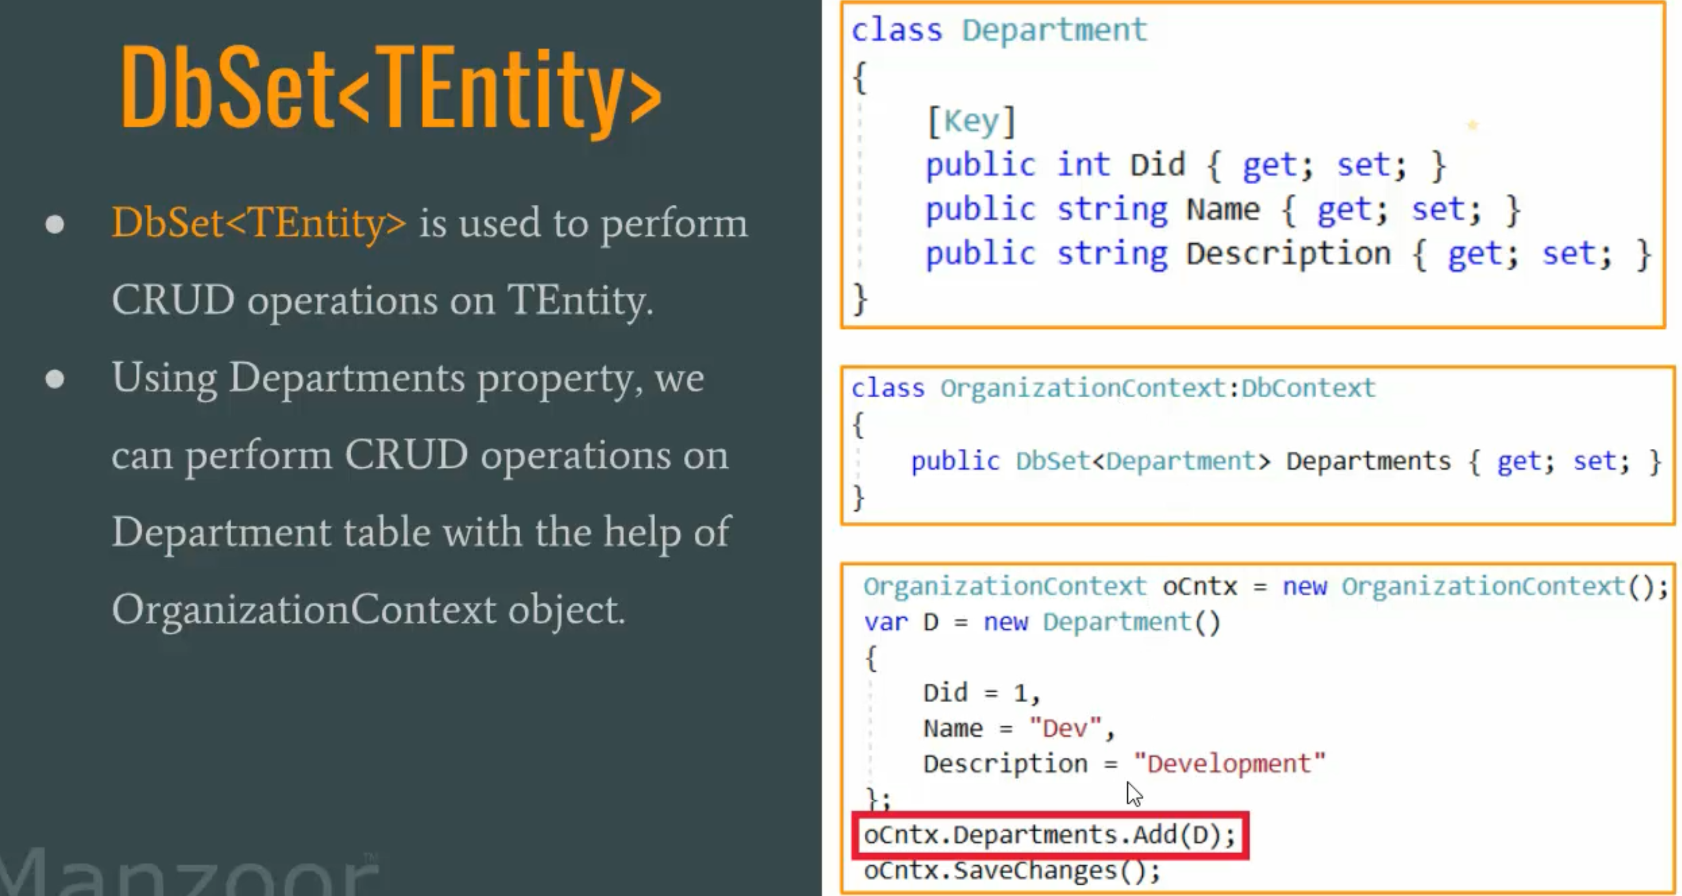
DbSet<TEntity>
DbSet<Tentity

Slide 5
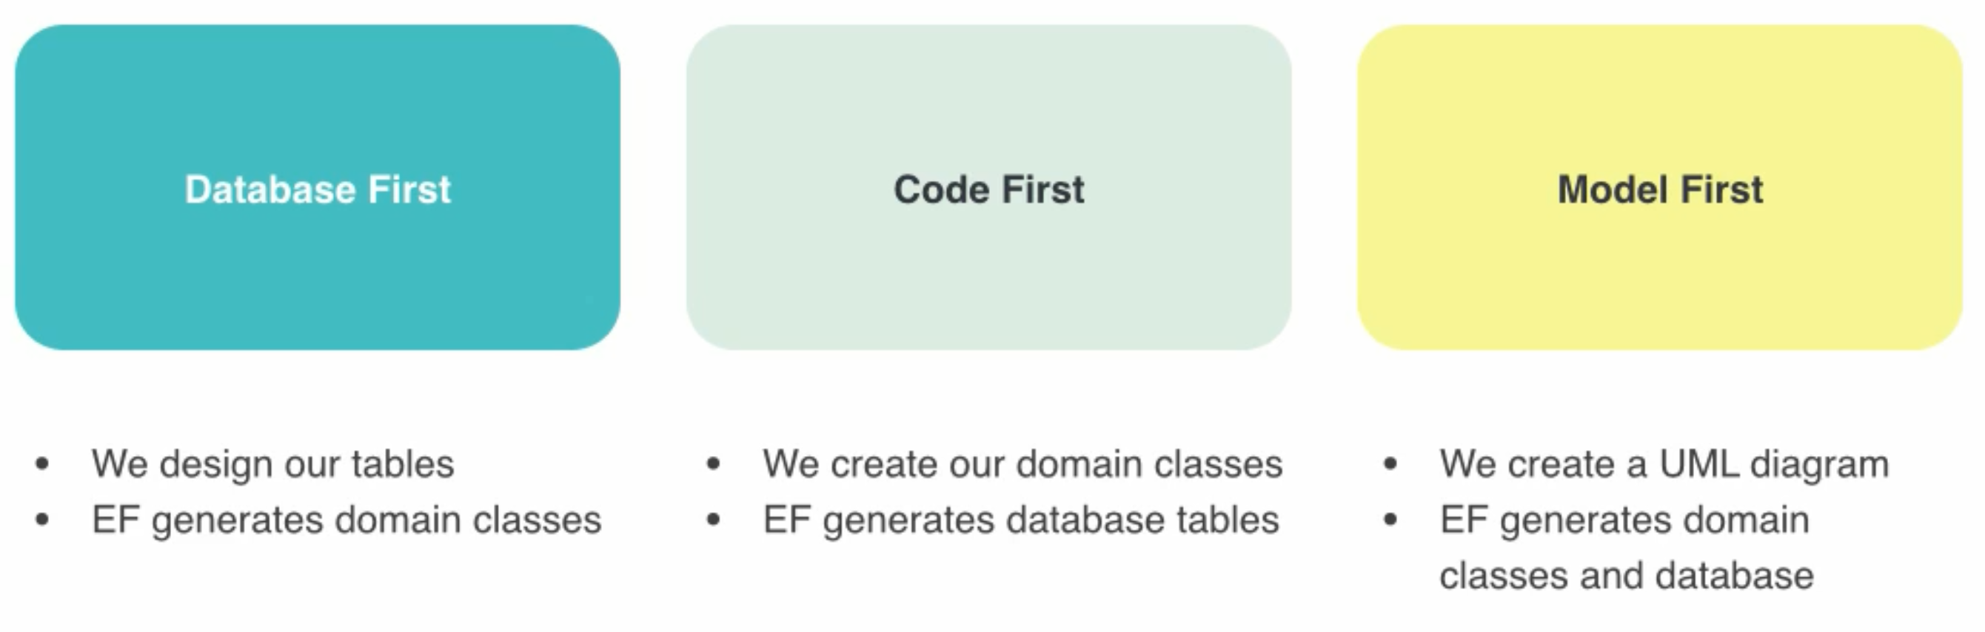
Workflows

